Slide 1

Presentation on AI CHATBOT-BANKING Of Bachelor of Engineering In Computer Science Engineering-(Big data and analytics) By MOHAMMED BILAL ANMOL PURWAR MUKUL KUMAR SINGH MUKHESH KUMAR Under the guidance of Prof Anshul Sharma Department-Computer science and Engineering

Slide 2
Outline
Problem Statement
Purpose
Introduction to our CHATBOT
Modules(Functions)
Conclusion

Slide 3
Problem statement
Weak supervision.
Meeting the increasing expectations of the customers.
Requirement of rapid response.
No proper interaction between the customer and the bank
Customer retention.
Lack of personalization.

Slide 4
Purpose
Try to solve the basic problems faced by the customer.
Reduction of fraud’s(giving remainder).
Giving better performance and reduction of costs.
Customer customized experience.
Consistent innovation.
24/7 digital support.
Taking feedback for improvement.

Slide 5
Introduction to the CHATBOT
A Chatbot is a computer program designed to mimic conversation with human users on the internet. Presenting chatbots in the banking segment can get a massive change in client experience. It helps in keeping up the pace bwith changing client desires.
Chatbot can computerize all the tedious inquiries which are dull and hugely affects the office’s execution. Banking, Financial Services and Insurance industries are now moving forward to use chatbot services in practice to improve the general banking for their valued clients.
Chatbot Baking objective is to provide customers with quicker support. At present, banking bots are equipped to undertake some basic tasks like bank account details, balance inquiry, loan queries, and more. For customers, this cuts down waiting time significantly, leading to a more positive banking experience.

Slide 6
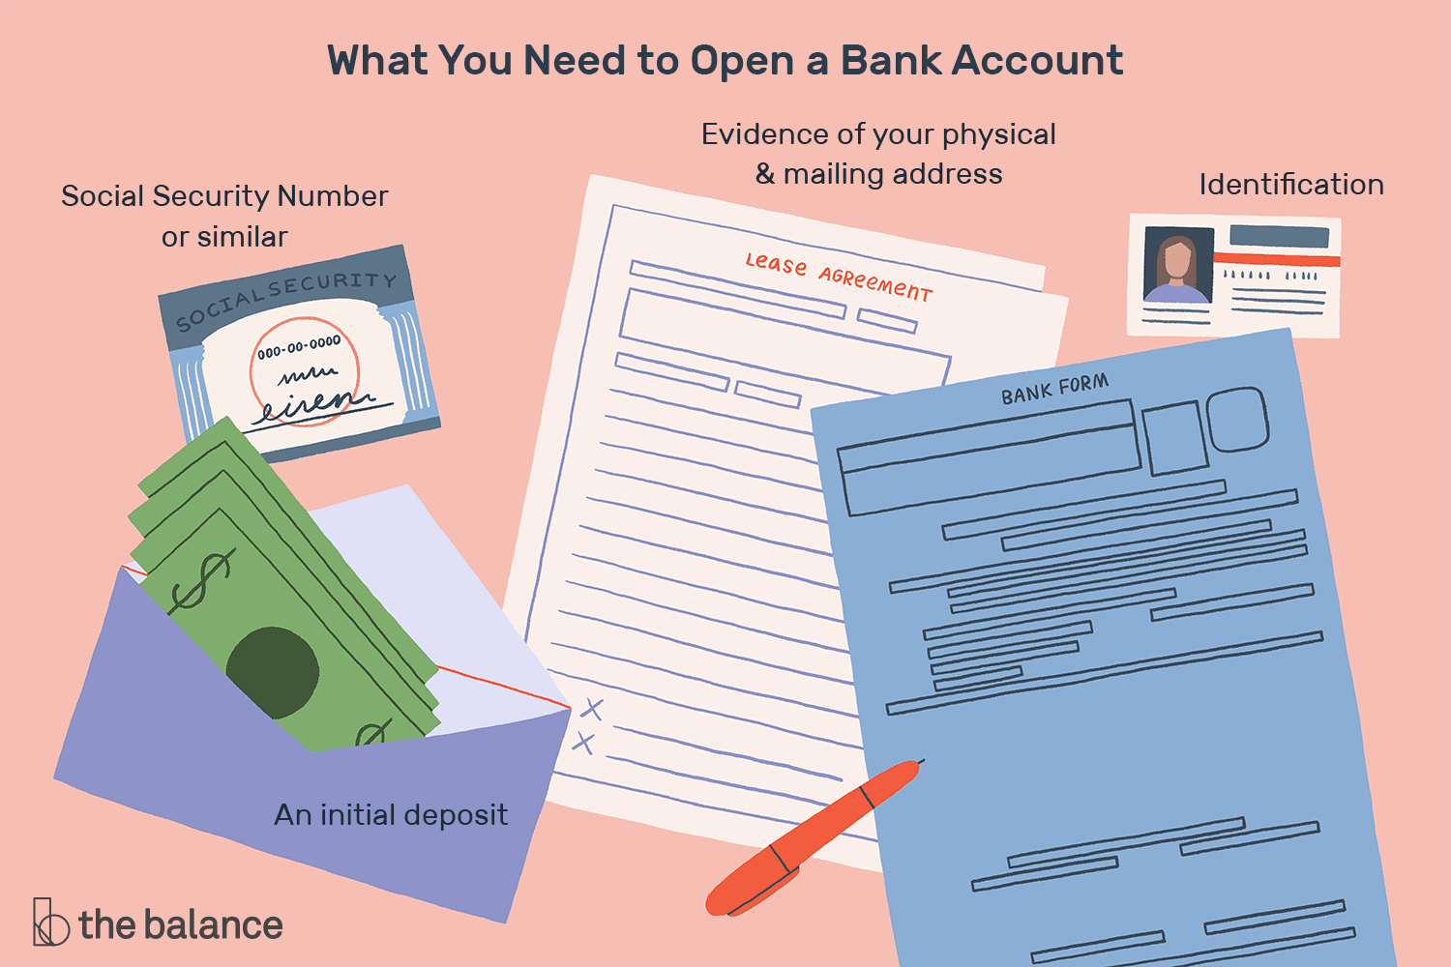
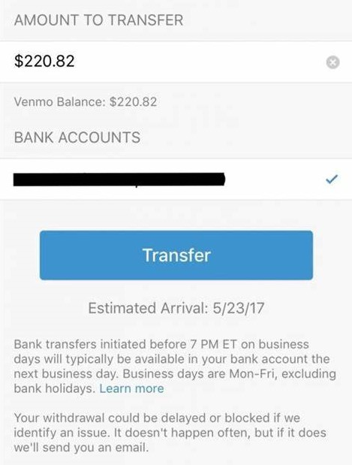
FUNCTIONS :
Create an account
Money transfer

Slide 7
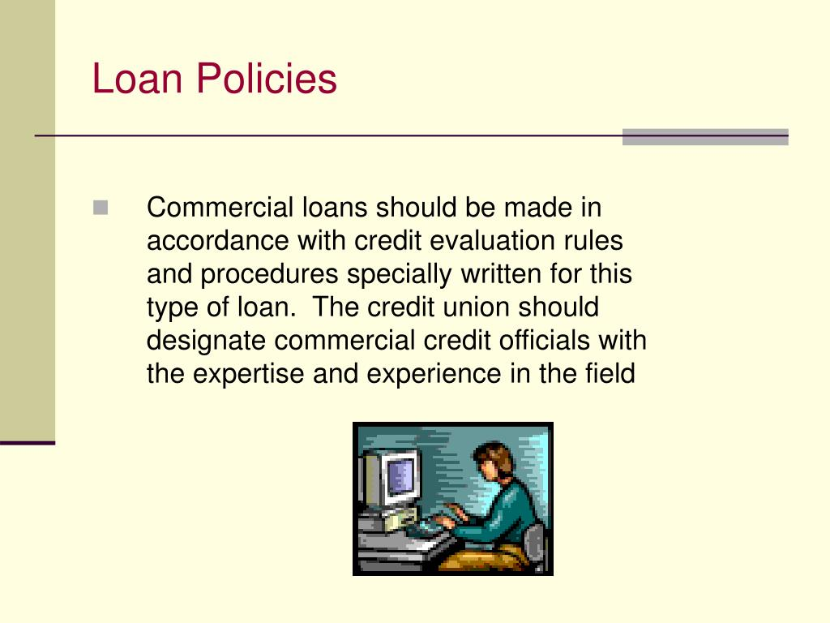
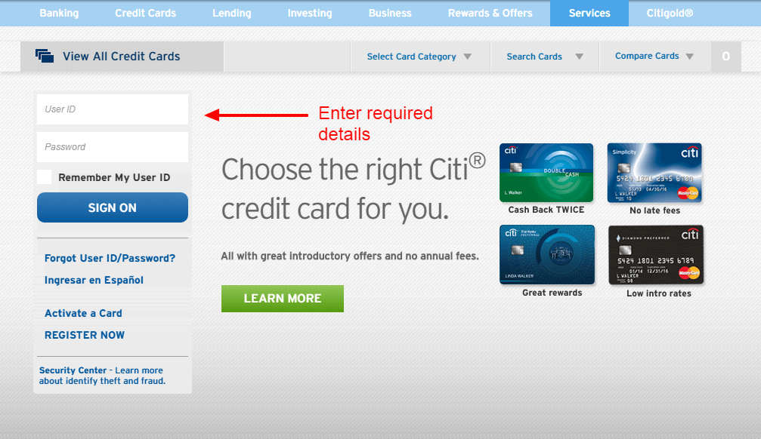
Functions:
Credit Card Application and Cancellation
Loan Policies

Slide 8
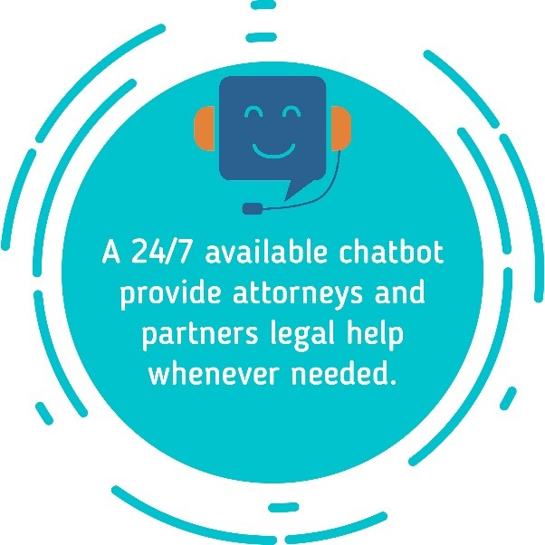
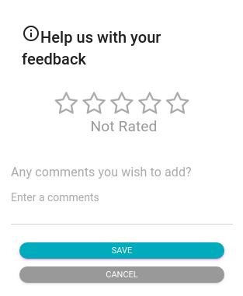
Functions:
Fast Service
Customer feedback

Slide 9
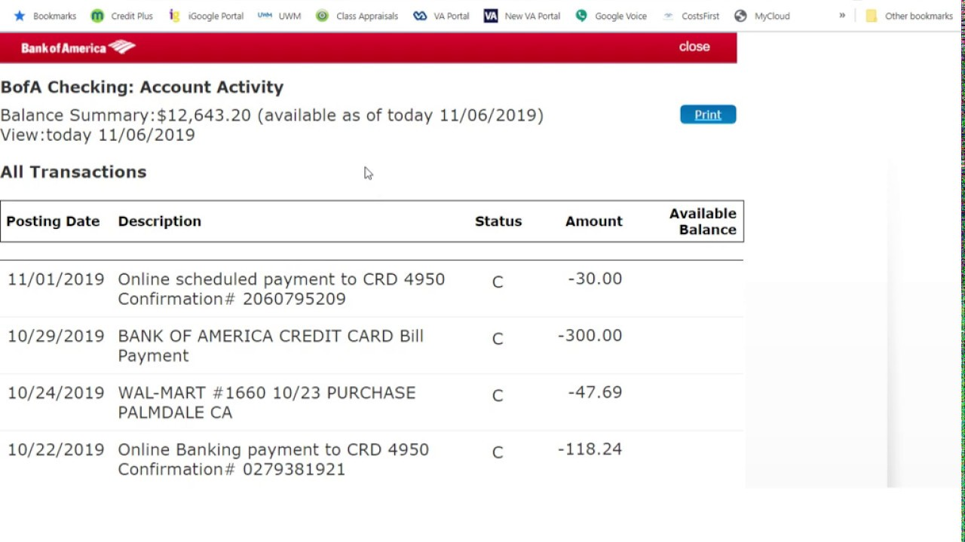
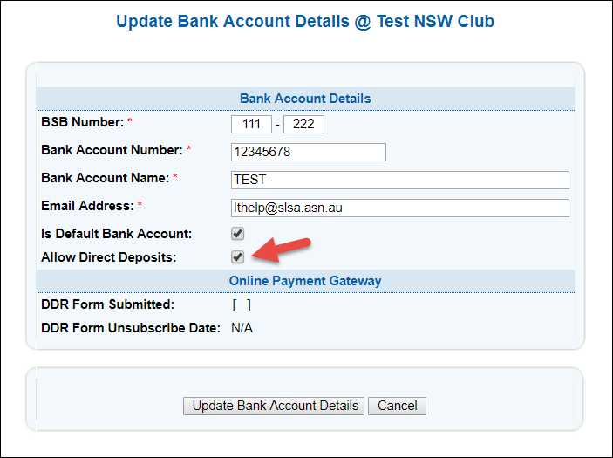
Functions:
Make a check about recent transaction details
Making adjustment in account details

Slide 10
CONCLUSION
This Chatbot empower banks to help customers whenever they need it. They can answer questions regarding financial matters 24/7, help customers handle simple banking operators, create an account, make money transactions, tell about loan policies, and many other tasks.
It provides fast service and better customer support. Since chatbots do not sleep, they are capable of instant replies. No matter how mundane the message, chatbots can provide helpful answers, thus, increasing the chances of converting first time visitors into active customers.
Automatized chat systems allow human agents to step into conversations and provide solutions. But chatbots are capable of more! Because they understand conversation contexts, AI chatbots can designate the right department to relevant messages.

